Slide 1

MJCET
Mechanical Engineering Department
Project Seminar -II
Design and structural analysis of Take-Out Robot
Date of Presentation:28-04-2022
Under the guidance of
Syed Adil(Asst. Professor)
Presented by:
Induru Ravi Teja (160418736066)
Mir Munavvar Ali(160418736080)
Syed Musharaf Hussain(160418736098)

Slide 2
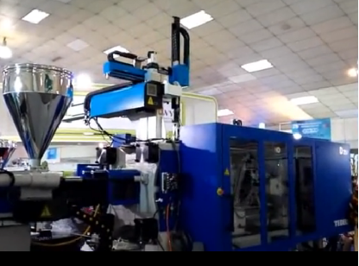
Table of contents
Introduction
Objective
Literature survey
Methodology
Design details
Applications
Advantages
Project timeline
References

Slide 3
Introduction
A robot is a automatic mechanical device which is guided by computer programme and electrical circuits.
It’s a machine resembling a human being and able to replicate certain human movements and functions automatically.
Robotic pick and place systems bring amazing speeds and precision to a manufacturing line. Pick and place robotic systems can pick up one or several objects and pack them into a box, carton, tray, or other type of container.
For this purpose “TAKEOUT ROBOT” is used.

Slide 4

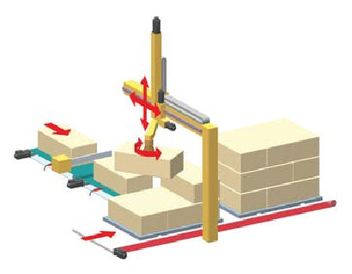
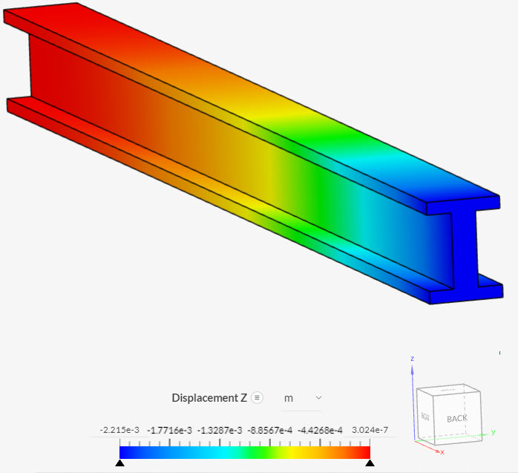
Objective
To design cost efficient 3 axis servo driven takeout robot and perform structural analysis for HBL power systems industry.

Slide 5
Literature survey
S.No | Authors, Year & Title | Observations & Remarks
1. | Design and Structural Analysis of a Robotic Arm Gurudu Rishank Reddy Venkata Krishna Prashanth Eranki ,Department of Mechanical Engineering, Blekinge Institute of Technology (BTH), Karlskrona, Sweden and Signode India Limited (SIG), Rudhraram, India from February 2016 to October 2016 under the supervision of R.V Jhansi Rao. | Automation is creating revolution in the present industrial sector, as it reduces manpower and time of production. After related study design of a 3-jointed robotic arm were the base is fixed and the remaining joints move in vertical & horizontal directions.The end effector is also designed such that to lift the sheet we use suction cups

Slide 6
Literature survey
S.No | Authors, Year & Title | Observations & Remarks
2. | DESIGN, ANALYSIS, AND CONTROL OF A PNEUMATIC CARTESIAN ROBOT Habib Abou-Fayssel: Design, Analysis, and Control of a Pneumatic Cartesian Robot USc. Thesis, Queen's University at Kingston, April, 1997 | A three degree of freedom Cartesian robot was designed for purposes of experimentation with various algorithms for tracking and position control. The robot was built &om basic off-the-shelf pneumatic components; thus it can be easily reproduced for mious applications in industry. Pneumatic actuators are of interest to us because of their large power output at a relatively low cost.

Slide 7
Literature survey
S.No | Authors, Year & Title | Observations & Remarks
3. | Mechanical Design of a Cartesian Manipulator for Warehouse Pick and Place A. English, C. Mccool, A. W. Tow, and T. Perez, “Autonomous Sweet Pepper Harvesting for Protected Cropping Systems, | Enabling robots to pick and place items within cluttered and challenging environments has direct application to industries such as e-commerce, logistics and even agriculture The entire manipulator system is mounted on an aluminium stand. It has three linear axes and a wrist joint which consists of a roll, pitch and yaw axis

Slide 8
Methodology
The takeout robot is utilised to pick up an injection moulded part from injection moulding machine, transfer it and place it on conveyor belt.
The solid modelling of individual part will be done using solidworks software.
The solid parts will be assembled in the assembly module of solidworks.
Structural analysis os the model will be performed using ANSYS software for various loads to ensure safety in design as well as to validate the design in terms of vibrations so that it ensures prevention of high amplitude of vibrations.

Slide 9
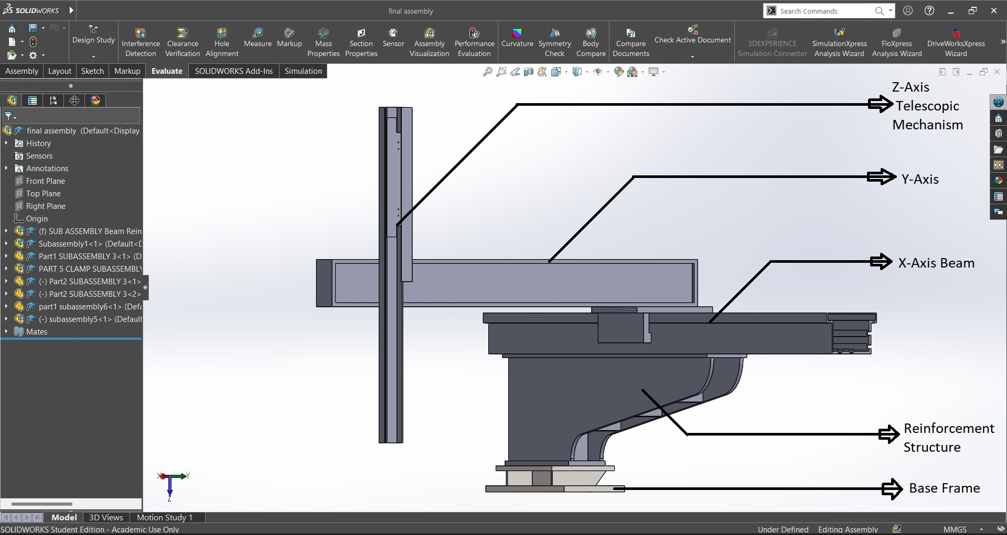
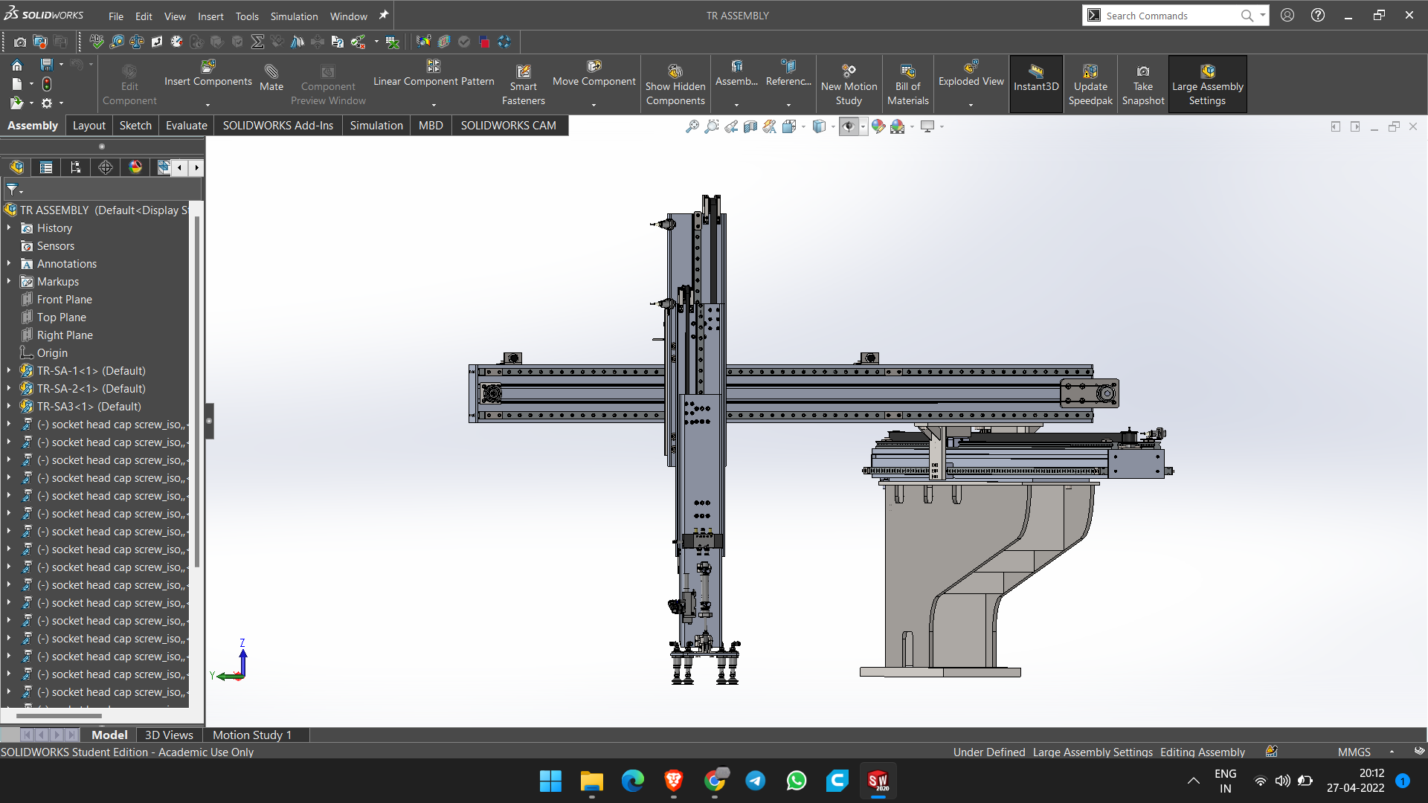
Design details
Initial model
Optimised model

Slide 10
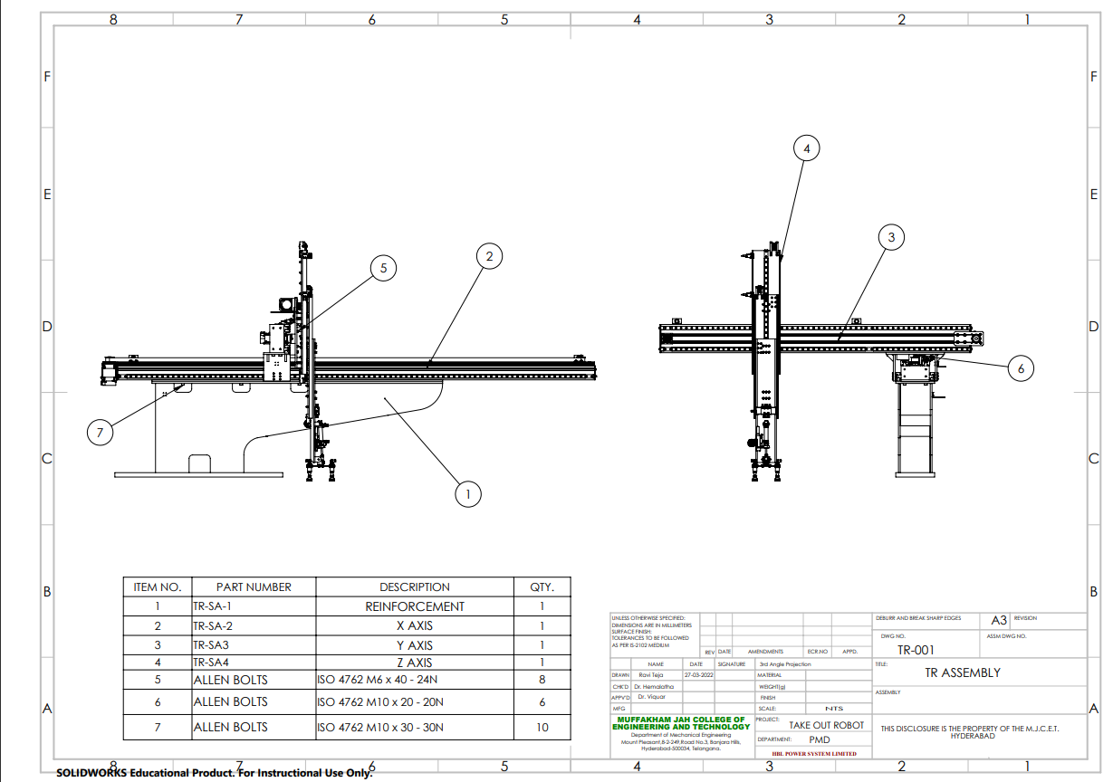

Slide 11
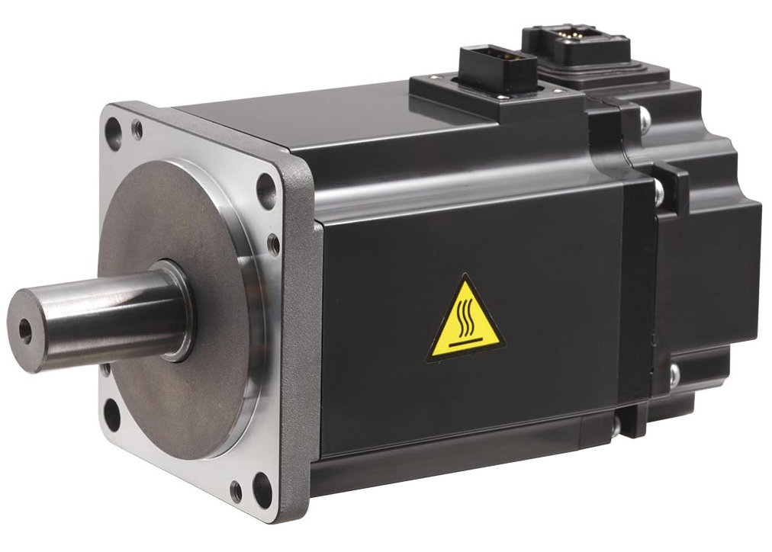
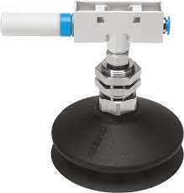
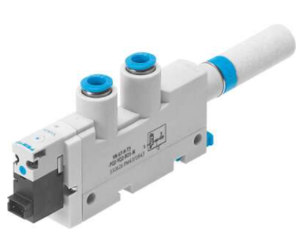
Components used & their reference
AC SERVO MOTOR:
Mitsubishi HG-KNJ series motors is selected to actuate the axes of the takeout robot connected through belt drive
Suction Gripper ESG:
This component has round bellow,1.5 convolution cup shape and sheet holds the suction cups between 2 nuts screwing along male thread.
Vacuum generator ,Electropneumatic VN
We decided to use one VN suction generator to each suction cup as it suits with the requirement. It can handle max 3 bar of suction pressure and can achieve 93% of max vacuum and it weights 63gms.

Slide 12
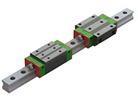
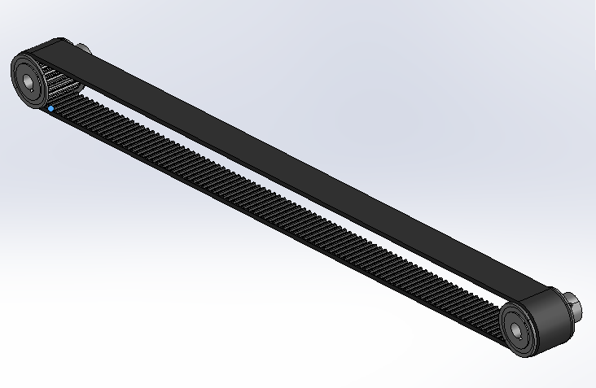
Components used & their reference
Linear Guide Rail:
Linear guideways provides linear motion by re-circulating rolling elements between a profiled rail and a bearing block
Timing Belt & Pulley:
The timing belt and pulleys are used to transfer the force and motion from motor

Slide 13
Sequence of Operation
Z-Axis- Three stage three belt drive telescopic mechanism
It has a C-channel as base on which linear guide ways , AC servo motor, and timing pulley and belt were attached.​
On the linear guideway 1 another linear guideways, timing pulley and belt were attached.​
Timing belt is attached to other sections in such a way that when the motor is powered and the telescopic mechanism is actuated.​

Slide 14
Sequence of Operation
Y-Axis -
This axis uses 2 linear guide rails to slide the z-axis along the beam using ac servo motor connected to mechanism using lead mechanism
X-Axis -
X- Axis is static placed on the reinforcement structure on which Y-Axis moves along using linear guide rails.
Final Task -
When the moulded part comes out of the moulding machine it picks and places the part to the desired area using pneumatics under limitations.

Slide 15
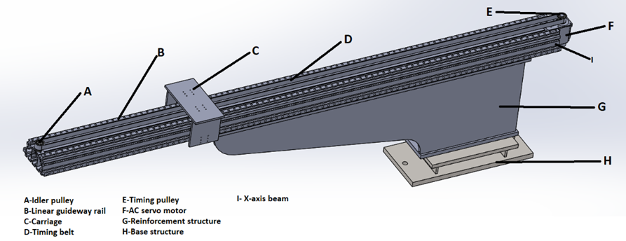
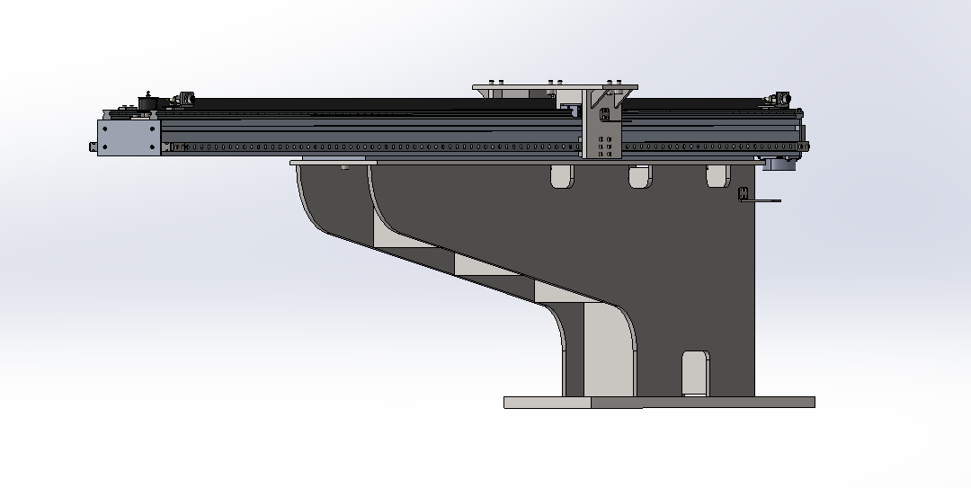
Design comparison
Initial model
X-Axis
Optimised model

Slide 16
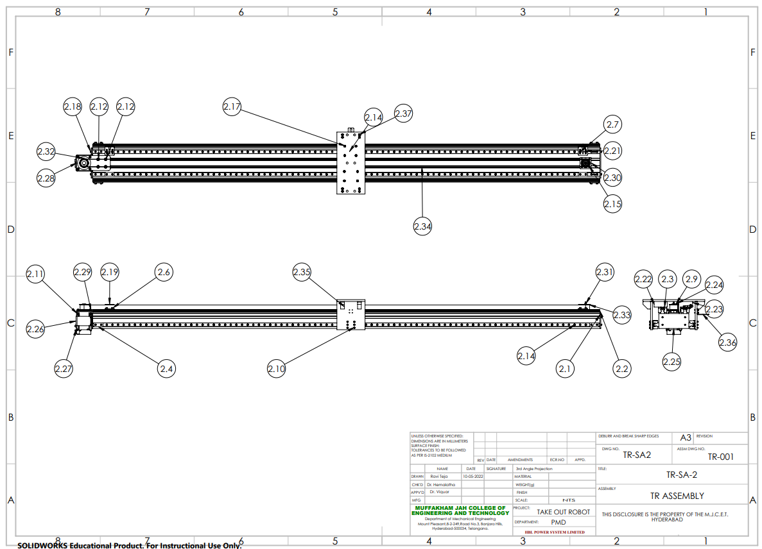

Slide 17
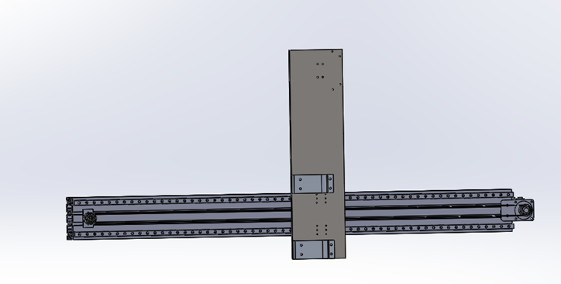
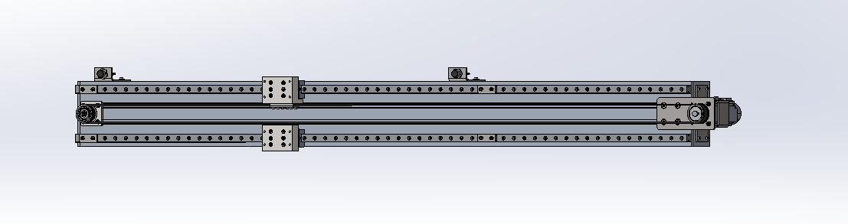
Initial model
Y-Axis
optimised model

Slide 18
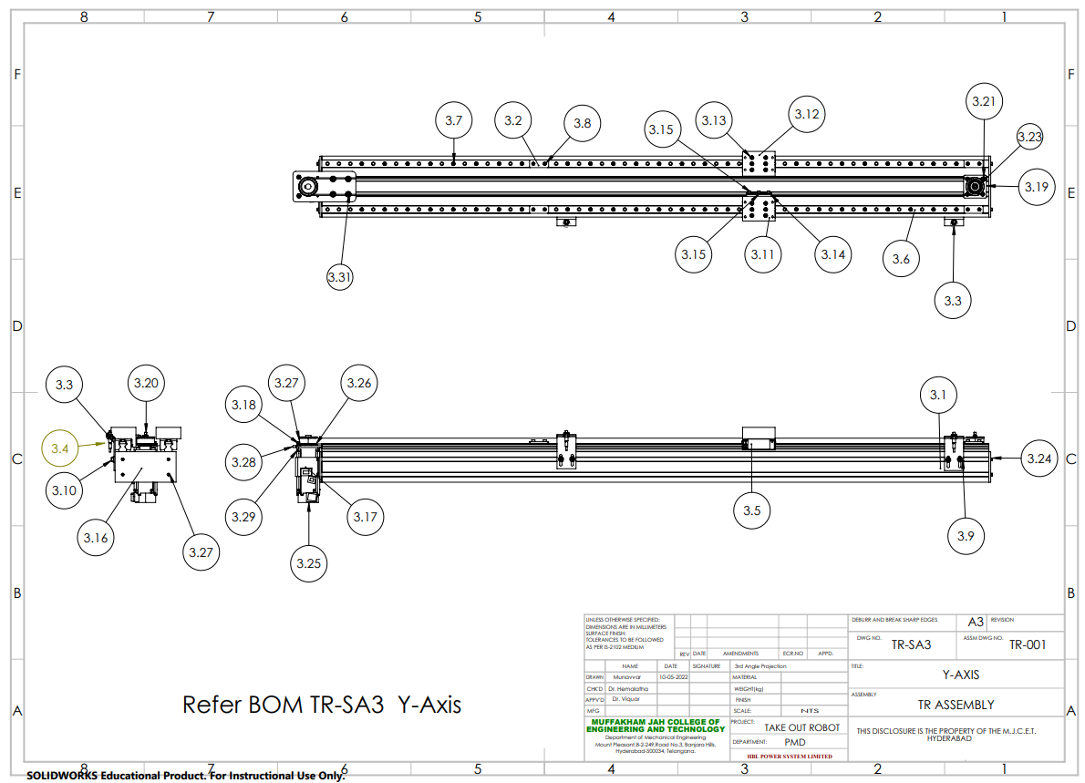

Slide 19
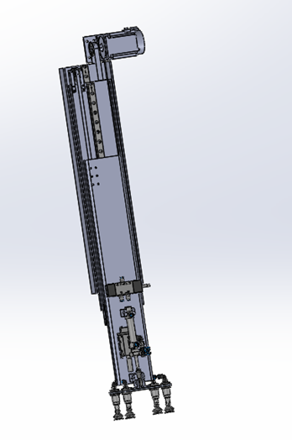
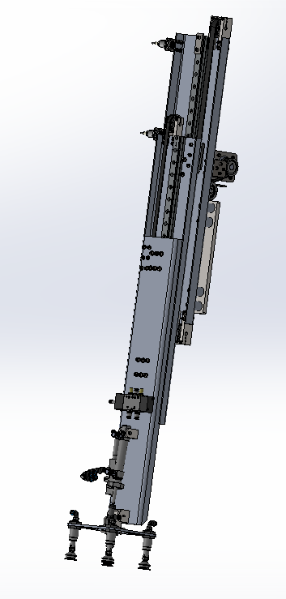
Z-Axis
Initial model
Optimised model

Slide 20
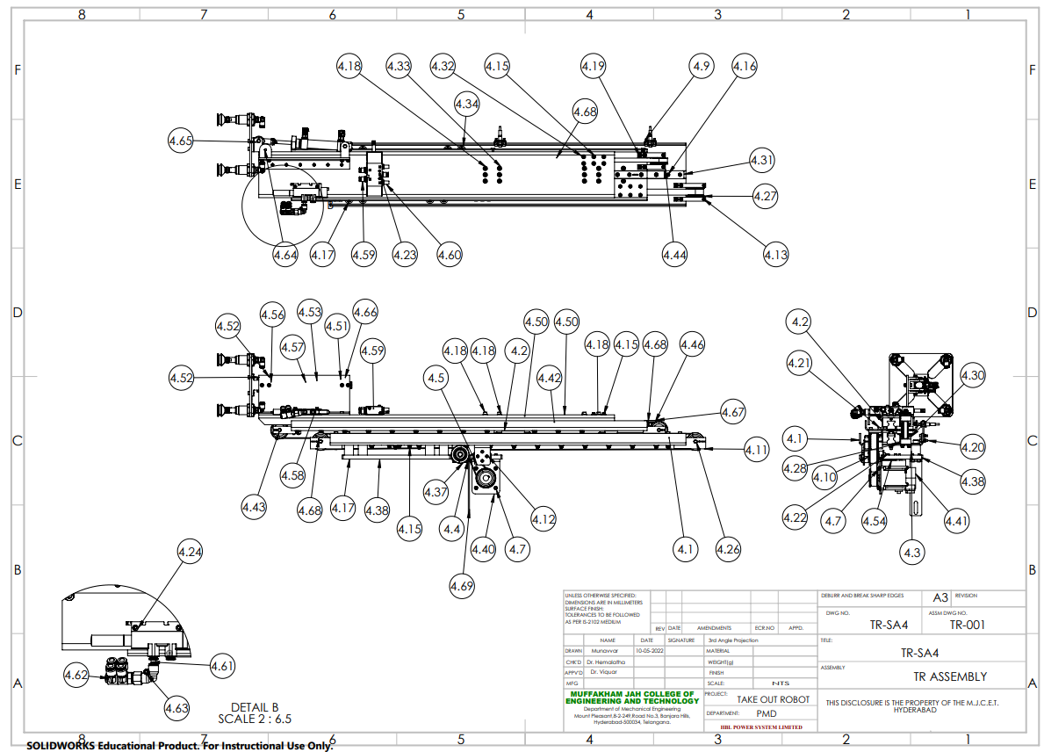

Slide 21
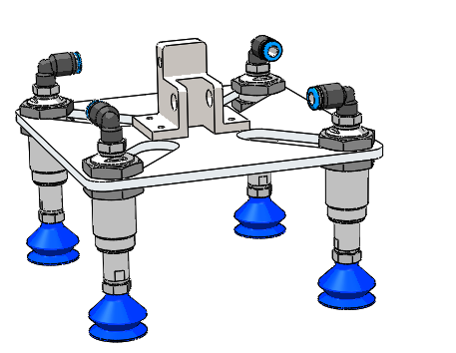
Calculations:
Vacuum Gripper
Theoretical Holding Force F_{th}= m (g + a) s
= 1.2 kg(9.81m/s² + 0.6 m/s²)
= 24.98 N
Suction Force F_{s} = F_{th}/n (Number of suction cups)
= 24.98/4
= 6.24 N
At 6 bar operating pressure ,Vacuum pressure generated - 0.9 bar (relative)
- 0.1 bar (absolute)
Suction rate (V) = 23.32 l/min
According to Pressure vs Force graph
At vacuum pressure 90 KPa
Suction force = 3.5 N

Slide 22
Loads of each mechanism:
Suction Force (F) = P*A
= (0.9*10⁵)(2.064*10⁻⁴)
= 18.57 N
= 1.89 Kg
Actual Force = F/S( Factor of safety)
= 1.894/2
= 0.94 kg
Loads on each axis motors:
On X-axis=65kg
On Y-axis=24kg
On Z-axis=13kg
Mechanism=175kg
On X-axis=72kg
On Y-axis=34kg
On Z-axis=18kg

Slide 23
Application
Material Handling
Industrial Robot Applications
Spraying and palletizing
Welding
Part sorting
Material packing
Assembling parts

Slide 24
Advantages
SPEED-pick and place allow for faster cycle times.
ACCURACY-Robotic systems are more accurate and consistence than their human counterparts.
Reliability-Robot can work 24 hours a day,seven days a week without stopping or tiring and The device should be able to consistently pick up and place objects in a smooth manner.
Flexibility-pick and place robots can be reprogrammable and tooling can be interchanged to provide for multiple applications.
Affordability-with the advancements in the technology,affordable robotics becoming available at less cost.

Slide 25
Project timeline
Designing
Of
Take-out robot
Bill of materials and final production drawings
SEPT
NOV
MAR
APRIL
Project Planning
and Research
Design and
development and finalization

Slide 26
References
[1] Minoru Baba, “Pick and Place for automatic test handler.” .
[2] Yang Liu and Michael Yu Yang, “Optimal Design of Remote Centre
Compiance Devices of Rotational Symmetry.” .
[3] “Robot end effector,” Wikipedia, the free encyclopedia.
[4] M. M. B. S. Pachaiyyapan and T.Sridhar, “Design and Analysis of an
Articulated Robotic Arm for various Industrial Applications,”.
[5] FANUC America Corporation, Automated Bottle Pallet Unloader with
FANUC Pick & Place Robot – Clear Automation.
[6] “Understanding Robot Specifications 101.” [Online]. Available:https://www.robots.com/blog/viewing/understanding-robot-specifications-101.

Slide 27
[7] “Materials for Robot building an introduction.” .
[8] “Ashby charts.” Mike Ashby.
[9] R. Stone, Fatigue Life Estimates using Goodman Diagrams. .
[10] Yahr, G.T., “36 Materials Science; Aluminium; Fatigue; Research Reactors; Pressure Vessels; Welded Joints; Neutron Sources 360103;Mechanical Properties.” Office of Scientific and Technical Information,01-June-1993.
[11] R.R. Moore, “Rotating Beam Fatigue Testing System.”
[12] K. N. R.Budnyas, Shigley’s Mechanical Engineering Design, Ninth.
Shigley.
[13]L. Sciavicco and B. Siciliano, Modelling and control of robot manipulators. Springer Science & Business Media.
[14]P. I. Corke, Robotics, vision and control : fundamental algorithms in
MATLAB. Berlin, Heidelberg: Springer.

Slide 28
THANK YOU

